Slide 1
CSM 61B Final Review
Post-MT2 Topics

Slide 2
Comparative sorts
Insertion, Selection, Heap, Merge, Quick
Ayush Sehgal

Slide 3
Comparison Based Sorting
All comparison based sorts are lower bounded by Omega(NlogN)
List considered sorted if for all i:
arr[i] < arr[i + 1]

Slide 4
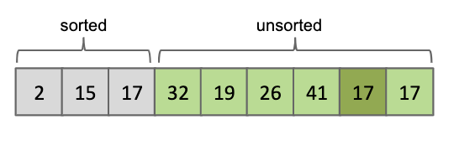
Selection Sort
Find smallest element
Swap this element to the front, never touch it again
Repeat for all items
Notice: you eventually get a sorted portion and an unsorted portion

Slide 5
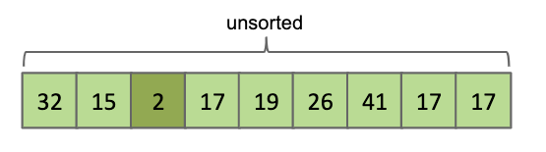
Find smallest element
Swap this element to the front, never touch it again
Repeat for all items

Slide 6
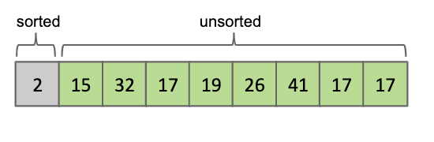
Find smallest element
Swap this element to the front, never touch it again
Repeat for all items

Slide 7
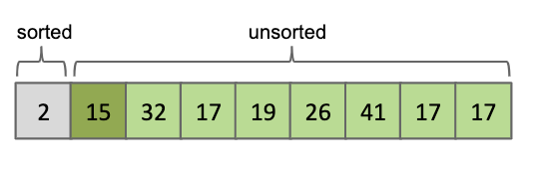
Find smallest element
Swap this element to the front, never touch it again
Repeat for all items

Slide 8
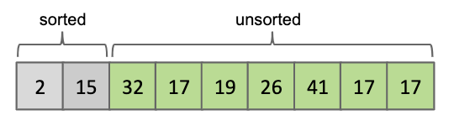
Find smallest element
Swap this element to the front, never touch it again
Repeat for all items

Slide 9
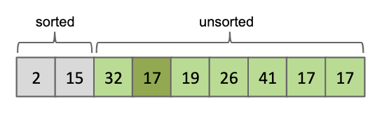
Find smallest element
Swap this element to the front, never touch it again
Repeat for all items

Slide 10
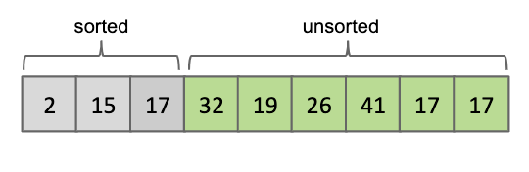
Find smallest element
Swap this element to the front, never touch it again
Repeat for all items

Slide 11
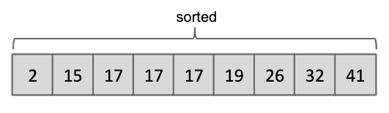
Find smallest element
Swap this element to the front, never touch it again
Repeat for all items

Slide 12
Selection Sort: Analysis
How long does it take to find the min of a list?
O(N)
How many times do we find the min?
N times. On a list of size N, then on a list of size N-1, so on..
N + N-1 + N-2 + … + 1 ~ O(N^2)
Can we make it faster?
No, there is no way around searching through the entire list to find the min

Slide 13
Insertion Sort
Inversion? - A pair of elements that are out of order
0 1 1 2 3 4 8 6 9 5 7
8-6, 8-5, 8-7, 6-5, 9-5, 9-7
Goal of all sorting: reduce number of inversions to 0

Slide 14
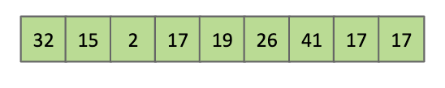
Insertion Sort
Set traveler from i = 0 to n-1
Swap item i backwards until it is in the right place

Slide 15
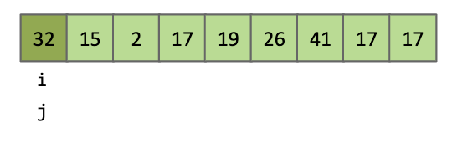
Set traveler from i = 0 to n-1
Swap item i backwards until it is in the right place

Slide 16
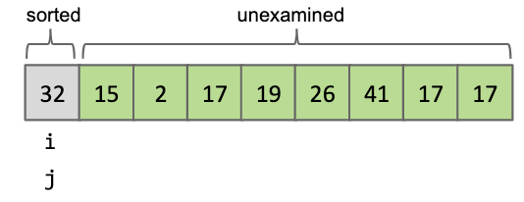
Set traveler from i = 0 to n-1
Swap item i backwards until it is in the right place

Slide 17
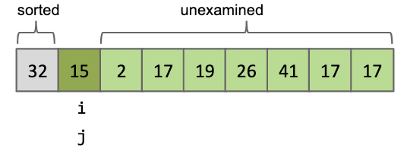
Set traveler from i = 0 to n-1
Swap item i backwards until it is in the right place

Slide 18
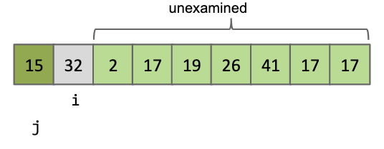
Set traveler from i = 0 to n-1
Swap item i backwards until it is in the right place

Slide 19
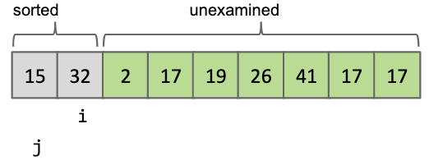
Set traveler from i = 0 to n-1
Swap item i backwards until it is in the right place

Slide 20
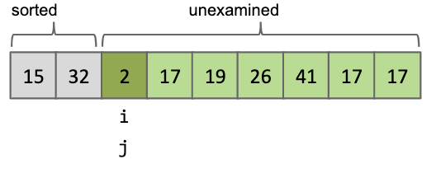
Set traveler from i = 0 to n-1
Swap item i backwards until it is in the right place

Slide 21
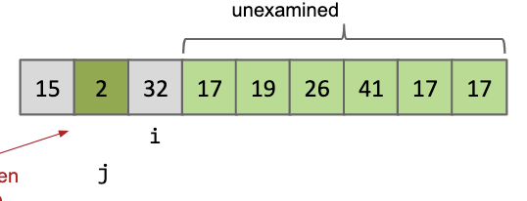
Set traveler from i = 0 to n-1
Swap item i backwards until it is in the right place

Slide 22
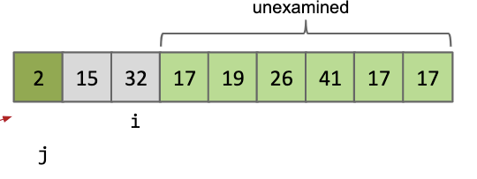
Set traveler from i = 0 to n-1
Swap item i backwards until it is in the right place

Slide 23
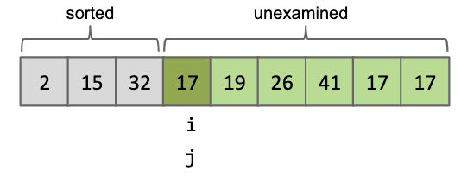
Set traveler from i = 0 to n-1
Swap item i backwards until it is in the right place

Slide 24
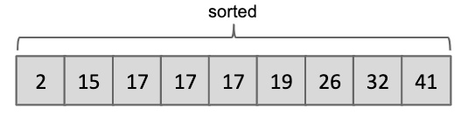
Set traveler from i = 0 to n-1
Swap item i backwards until it is in the right place

Slide 25
Insertion Sort: Analysis
Best Case: Sorted Array
Everything is sorted (j will never increment) just run through array once → O(N)
Worst Case: Backwards Array
Every item i needs to be swapped around N times
First item requires 1 swap, second item requires 2, etc…
O(N^2)

Slide 26
Insertion Sort: Analysis
General Runtime:
Depends on number of inversions
O(N + k)
Where k is the number of inversions
When would we use this?
On small arrays or arrays that are partially sorted
Java sort() defaults to insertion sort on small arrays

Slide 27
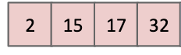
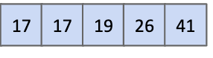
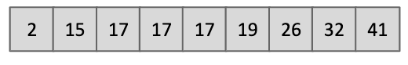
Merge Sort
Split array into two roughly even pieces
Call Merge sort on each half (Recursion!)
Merge two sorted halves
What’s Merge(arr1,arr2)?

Slide 28
Merge Sort
Split array into two roughly even pieces
Call Merge sort on each half (Recursion!)
Merge two sorted halves
What’s Merge(arr1,arr2)?

Slide 29
Merge Sort
Split array into two roughly even pieces
Call Merge sort on each half (Recursion!)
Merge two sorted halves
What’s Merge(arr1,arr2)?

Slide 30
Merge Sort
Split array into two roughly even pieces
Call Merge sort on each half (Recursion!)
Merge two sorted halves
What’s Merge(arr1,arr2)?

Slide 31
Merge Sort
Split array into two roughly even pieces
Call Merge sort on each half (Recursion!)
Merge two sorted halves
What’s Merge(arr1,arr2)?

Slide 32
Merge Sort
Split array into two roughly even pieces
Call Merge sort on each half (Recursion!)
Merge two sorted halves
What’s Merge(arr1,arr2)?

Slide 33
Merge Sort
Split array into two roughly even pieces
Call Merge sort on each half (Recursion!)
Merge two sorted halves
What’s Merge(arr1,arr2)?

Slide 34
Merge Sort
Split array into two roughly even pieces
Call Merge sort on each half (Recursion!)
Merge two sorted halves
What’s Merge(arr1,arr2)?

Slide 35
Merge Sort
Split array into two roughly even pieces
Call Merge sort on each half (Recursion!)
Merge two sorted halves
What’s Merge(arr1,arr2)?

Slide 36
Merge Sort
Split array into two roughly even pieces
Call Merge sort on each half (Recursion!)
Merge two sorted halves
What’s Merge(arr1,arr2)?

Slide 37
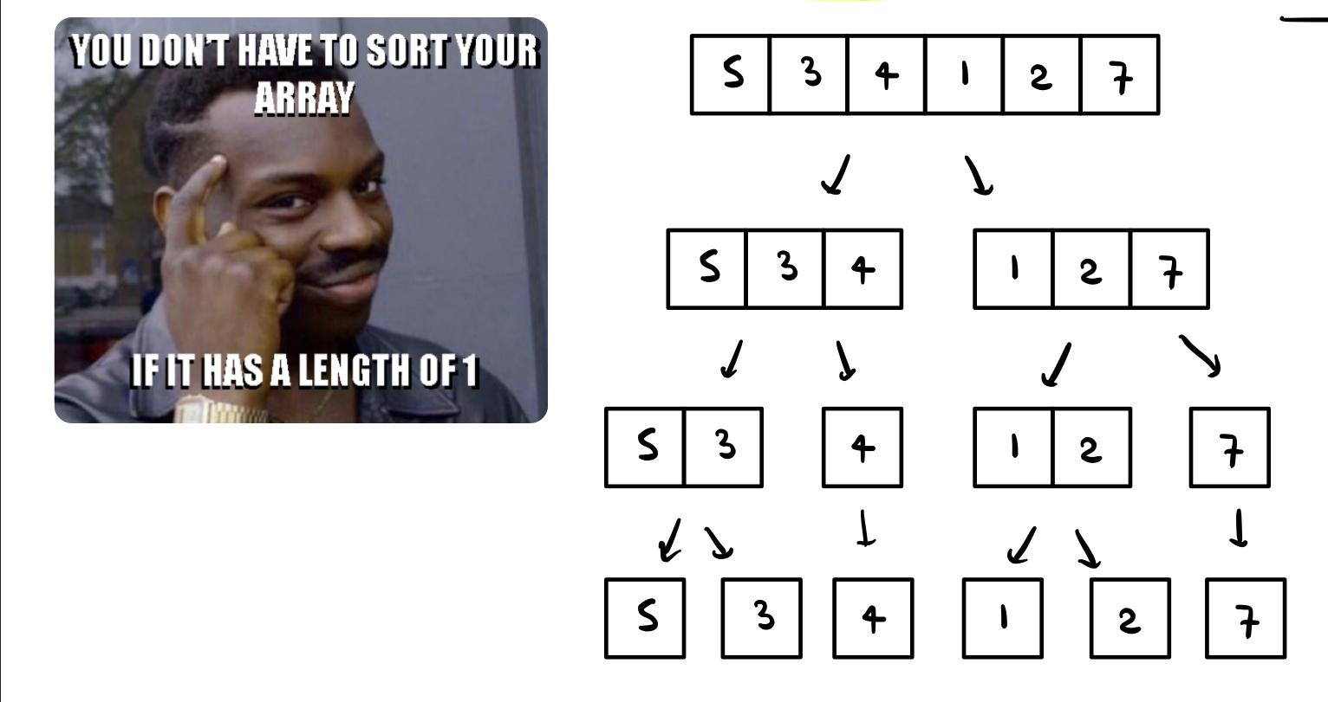
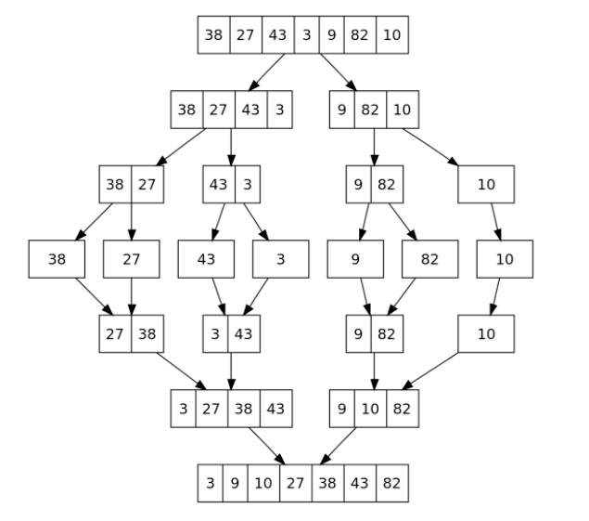

Slide 38
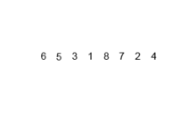

Slide 39
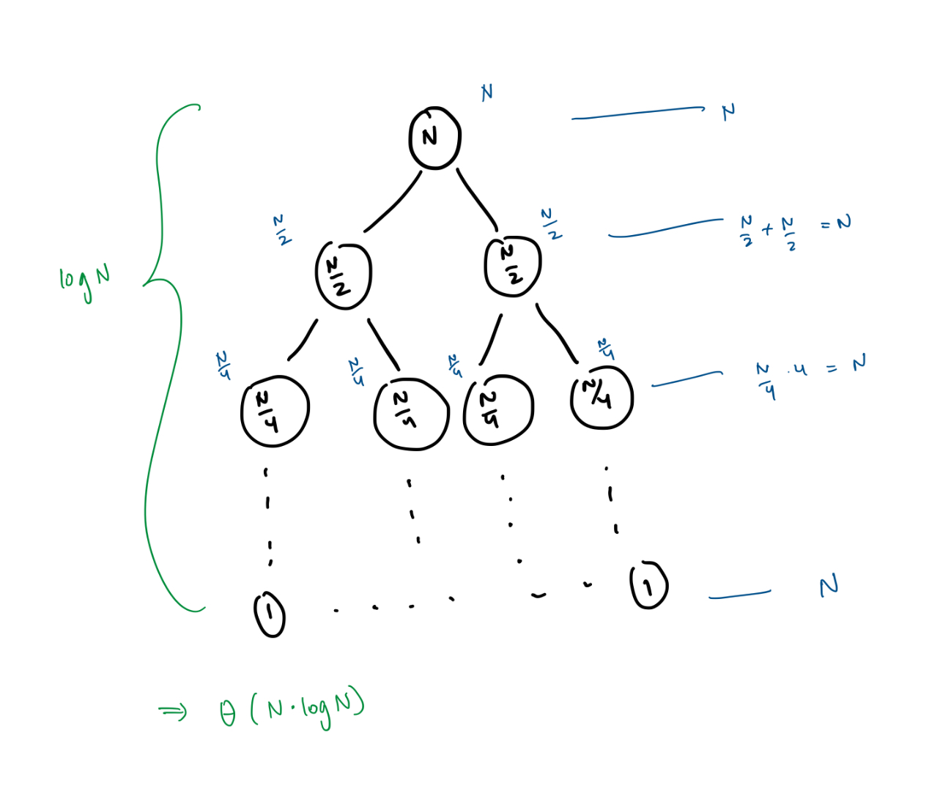
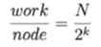
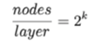
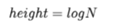
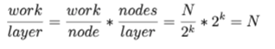
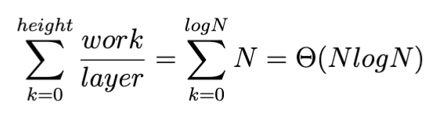
Merge Sort: Analysis
Merge at each level takes linear time: O(N)
Let k be the level you are at now (root has k=0)
Total Runtime =

Slide 40
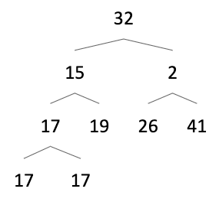
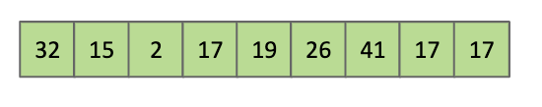
Heapsort (in-place)
Max heapify the array
Bottom up reverse level order
Delete largest item from max heap, swap with last item in heap

Slide 41
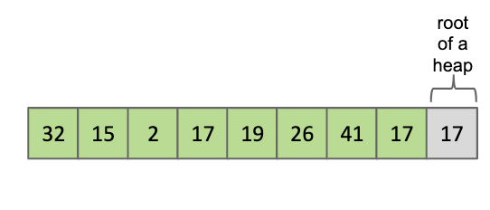
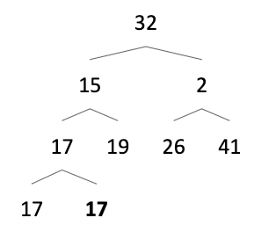
Max heapify the array
Bottom up reverse level order
Delete largest item from max heap, swap with last item in heap

Slide 42
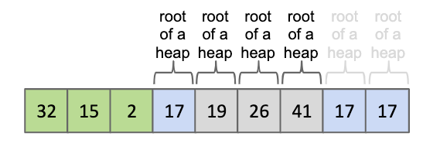
Max heapify the array
Bottom up reverse level order
Delete largest item from max heap, swap with last item in heap

Slide 43
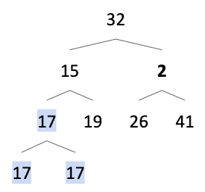
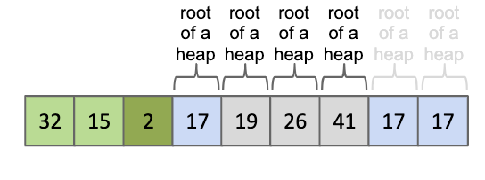
Max heapify the array
Bottom up reverse level order
Delete largest item from max heap, swap with last item in heap

Slide 44
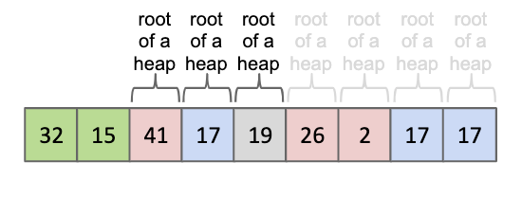
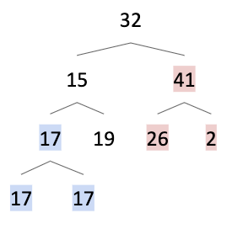
Max heapify the array
Bottom up reverse level order
Delete largest item from max heap, swap with last item in heap

Slide 45
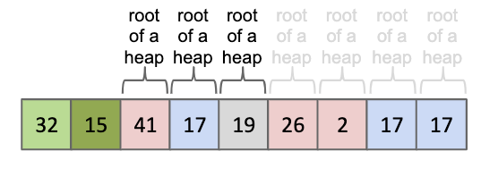
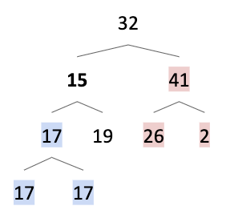
Max heapify the array
Bottom up reverse level order
Delete largest item from max heap, swap with last item in heap

Slide 46
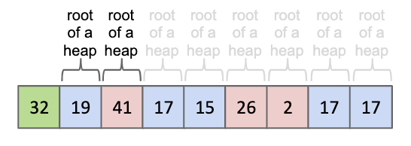
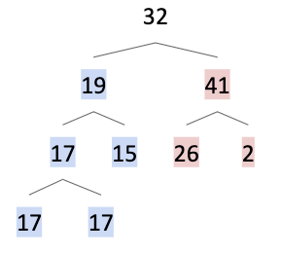
Max heapify the array
Bottom up reverse level order
Delete largest item from max heap, swap with last item in heap

Slide 47
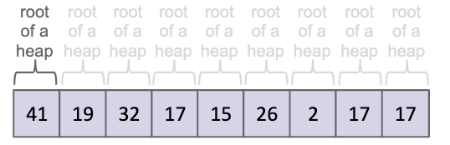
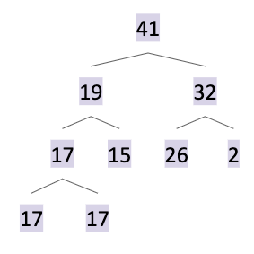
Max heapify the array
Bottom up reverse level order
Delete largest item from max heap, swap with last item in heap

Slide 48
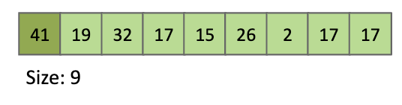
Max heapify the array
Bottom up reverse level order
Delete largest item from max heap, swap with last item in heap

Slide 49
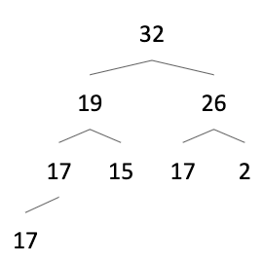
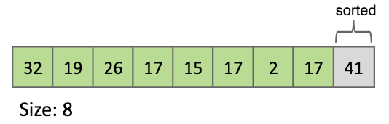
Max heapify the array
Bottom up reverse level order
Delete largest item from max heap, swap with last item in heap

Slide 50
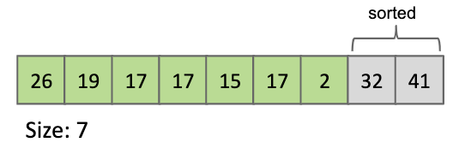

Max heapify the array
Bottom up reverse level order
Delete largest item from max heap, swap with last item in heap

Slide 51

Max heapify the array
Bottom up reverse level order
Delete largest item from max heap, swap with last item in heap

Slide 52
Heapsort (in-place): Analysis
Two Methods
Max Heapify then perform in place
Max Heapify then remove min and populate a separate array
Heap operations take O(logN) time because heaps are balanced with height logN
In-place: remove max requires O(logN), removing max N times = O(NlogN)
Special Case: array comes in heap form → O(N)

Slide 53

Quicksort
Choose pivot
Partition into a group less than pivot, equal to pivot, larger than pivot
Quicksort on each group (Recursion!)

Slide 54

Choose pivot (leftmost)
Partition into a group less than pivot, equal to pivot, larger than pivot
Quicksort on each group (Recursion!)

Slide 55

Choose pivot (leftmost)
Partition into a group less than pivot, equal to pivot, larger than pivot
Quicksort on each group (Recursion!)

Slide 56

Choose pivot (leftmost)
Partition into a group less than pivot, equal to pivot, larger than pivot
Quicksort on each group (Recursion!)

Slide 57

Choose pivot (leftmost)
Partition into a group less than pivot, equal to pivot, larger than pivot
Quicksort on each group (Recursion!)

Slide 58

Choose pivot (leftmost)
Partition into a group less than pivot, equal to pivot, larger than pivot
Quicksort on each group (Recursion!)

Slide 59

Choose pivot (leftmost)
Partition into a group less than pivot, equal to pivot, larger than pivot
Quicksort on each group (Recursion!)

Slide 60


Slide 61

Quicksort: Analysis
Depends! On what? Pivot! Because that determines
what the levels of recursion look like.
Best Case: median element is the pivot → O(NlogN)
Acts like mergesort
Worst Case: choose smallest or largest element in list → O(N^2)
Acts like selection sort

Slide 62
Quicksort: Analysis
Why is this useful?
Worst case probability is low:
Prob(choose smallest element) = 1/N
Prob(next smallest element after first partition) = 1/(N-1)
Prob(choosing smallest all the time) = 1/N! → TINY!
Therefore, worst case will barely happen

Slide 63
Quicksort: Analysis
So runtime is: O(N^2)

Slide 64
Spring ‘16 Final
Word Bank: (some questions may have multiple correct answers)
Selection sort,
Insertion sort,
Mergesort,
Heapsort,
Quicksort
__________ is bounded by Ω(N log N) lower bound
__________ is a comparison based sort and has worst case runtime that is asymptotically better than Quicksort worst case runtime
__________ in the worst case, performs Θ(N) pairwise swaps of elements
__________ comparison based sort, and never compares the same two elements twice.
__________ runs in best case Θ(log N) time for specific inputs

Slide 65
Spring ‘16 Final
Word Bank: (some questions may have multiple correct answers)
Selection sort,
Insertion sort,
Mergesort,
Heapsort,
Quicksort
A, C, E is bounded by Ω(N log N) lower bound
B,D can run in linear time
C, D is a comparison based sort and has worst case runtime that is asymptotically better than Quicksort worst case runtime
C, D both upper bounded by NlogN
A, B in the worst case, performs Θ(N) pairwise swaps of elements

Slide 66
Spring ‘16 Final
Word Bank: (some questions may have multiple correct answers)
Selection sort,
Insertion sort,
Mergesort,
Heapsort,
Quicksort
B, C, E, comparison based sort, and never compares the same two elements twice.
None of them run in best case Θ(log N) time for specific inputs
As we know, all comparison based sorts are lower bounded by Ω(N log N)

Slide 67
Counting Sorts
aka Distribution Sort
Enya Xing

Slide 68
Key | Val
2 | A
3 | B
1 | C
3 | D
1 | E
Unsorted

Slide 69
Key | Val
2 | A
3 | B
1 | C
3 | D
1 | E
Key | Count
1
2
3
Tally Counts
Unsorted
Create an array to store counts

Slide 70
Key | Val
2 | A
3 | B
1 | C
3 | D
1 | E
Key | Count
1 | 2
2 | 1
3 | 2
Tally Counts
Unsorted
(2) Iterate through unsorted array, increment appearances of each key in count array

Slide 71
Key | Val
2 | A
3 | B
1 | C
3 | D
1 | E
Key | Count
1 | 2
2 | 1
3 | 2
Key | Start
1 | 0
2 | 0 + 2 = 2
3 | 2 + 1 = 3
Tally Counts
Start Index
Unsorted
(3) Create an array to store starting indices and calculate starting indices

Slide 72
Key | Val
2 | A
3 | B
1 | C
3 | D
1 | E
Key | Count
1 | 1
2 | 2
3 | 3
Key | Start
1 | 0
2 | 2
3 | 3
Tally Counts
Start Index
Unsorted

Slide 73
Key | Val
2 | A
3 | B
1 | C
3 | D
1 | E
Key | Count
1 | 1
2 | 2
3 | 3
Key | Start
1 | 0
2 | 2
3 | 3
Index | Key | Val
0
1
2
3
4
Tally Counts
Start Index
Unsorted
(4) Create an array to store ordered version

Slide 74
Key | Val
2 | A
3 | B
1 | C
3 | D
1 | E
Key | Count
1 | 1
2 | 2
3 | 3
Key | Start
1 | 0
2 | 2
3 | 3
Index | Key | Val
0
1
2
3
4
Tally Counts
Start Index
Unsorted
(5) Copy items from original array to sorted array. Follow the target positions
calculated and update accordingly.

Slide 75
Key | Val
2 | A
3 | B
1 | C
3 | D
1 | E
Key | Count
1 | 1
2 | 2
3 | 3
Key | Start
1 | 0
2 | 3
3 | 3
Index | Key | Val
0
1
2 | 2 | A
3
4
Tally Counts
Start Index
Unsorted
(5) Copy items from original array to sorted array. Follow the target positions
calculated and update accordingly.

Slide 76
Key | Val
2 | A
3 | B
1 | C
3 | D
1 | E
Key | Count
1 | 1
2 | 2
3 | 3
Key | Start
1 | 0
2 | 3
3 | 3
Index | Key | Val
0
1
2 | 2 | A
3
4
Tally Counts
Start Index
Unsorted
(5) Copy items from original array to sorted array. Follow the target positions
calculated and update accordingly.

Slide 77
Key | Val
2 | A
3 | B
1 | C
3 | D
1 | E
Key | Count
1 | 1
2 | 2
3 | 3
Key | Start
1 | 0
2 | 3
3 | 4
Index | Key | Val
0
1
2 | 2 | A
3 | 3 | B
4
Tally Counts
Start Index
Unsorted
(5) Copy items from original array to sorted array. Follow the target positions
calculated and update accordingly.

Slide 78
Key | Val
2 | A
3 | B
1 | C
3 | D
1 | E
Key | Count
1 | 1
2 | 2
3 | 3
Key | Start
1 | 0
2 | 3
3 | 4
Index | Key | Val
0
1
2 | 2 | A
3 | 3 | B
4
Tally Counts
Start Index
Unsorted
(5) Copy items from original array to sorted array. Follow the target positions
calculated and update accordingly.

Slide 79
Key | Val
2 | A
3 | B
1 | C
3 | D
1 | E
Key | Count
1 | 1
2 | 2
3 | 3
Key | Start
1 | 1
2 | 3
3 | 4
Index | Key | Val
0 | 1 | C
1
2 | 2 | A
3 | 3 | B
4
Tally Counts
Start Index
Unsorted
(5) Copy items from original array to sorted array. Follow the target positions
calculated and update accordingly.

Slide 80
Key | Val
2 | A
3 | B
1 | C
3 | D
1 | E
Key | Count
1 | 1
2 | 2
3 | 3
Key | Start
1 | 1
2 | 3
3 | 4
Index | Key | Val
0 | 1 | C
1
2 | 2 | A
3 | 3 | B
4
Tally Counts
Start Index
Unsorted
(5) Copy items from original array to sorted array. Follow the target positions
calculated and update accordingly.

Slide 81
Key | Val
2 | A
3 | B
1 | C
3 | D
1 | E
Key | Count
1 | 1
2 | 2
3 | 3
Key | Start
1 | 1
2 | 3
3 | 5
Index | Key | Val
0 | 1 | C
1
2 | 2 | A
3 | 3 | B
4 | 3 | D
Tally Counts
Start Index
Unsorted
(5) Copy items from original array to sorted array. Follow the target positions
calculated and update accordingly.

Slide 82
Key | Val
2 | A
3 | B
1 | C
3 | D
1 | E
Key | Count
1 | 1
2 | 2
3 | 3
Key | Start
1 | 1
2 | 3
3 | 5
Index | Key | Val
0 | 1 | C
1
2 | 2 | A
3 | 3 | B
4 | 3 | D
Tally Counts
Start Index
Unsorted
(5) Copy items from original array to sorted array. Follow the target positions
calculated and update accordingly.

Slide 83
Key | Val
2 | A
3 | B
1 | C
3 | D
1 | E
Key | Count
1 | 1
2 | 2
3 | 3
Key | Start
1 | 2
2 | 3
3 | 5
Index | Key | Val
0 | 1 | C
1 | 1 | E
2 | 2 | A
3 | 3 | B
4 | 3 | D
Tally Counts
Start Index
Unsorted
(5) Copy items from original array to sorted array. Follow the target positions
calculated and update accordingly.

Slide 84
Key | Val
2 | A
3 | B
1 | C
3 | D
1 | E
Key | Count
1 | 1
2 | 2
3 | 3
Key | Start
1 | 2
2 | 3
3 | 5
Index | Key | Val
0 | 1 | C
1 | 1 | E
2 | 2 | A
3 | 3 | B
4 | 3 | D
Tally Counts
Start Index
Sorted!
Unsorted
we are done!

Slide 85
Counting Sort Runtime?

Slide 86
Key | Val
2 | A
3 | B
1 | C
3 | D
1 | E
Key | Count
1 | 1
2 | 2
3 | 3
Key | Start
1 | 1
2 | 3
3 | 5
Index | Key | Val
0 | 1 | C
1 | 1 | E
2 | 2 | A
3 | 3 | B
4 | 3 | D
Definitions
R = number of letters in alphabet (keys)
N = number of items to be sorted

Slide 87
Key | Val
2 | A
3 | B
1 | C
3 | D
1 | E
Key | Count
1 | 1
2 | 2
3 | 3
Key | Start
1 | 1
2 | 3
3 | 5
Index | Key | Val
0 | 1 | C
1 | 1 | E
2 | 2 | A
3 | 3 | B
4 | 3 | D
Create an array size R to store counts.
N time to tally keys.
Create an array size R to store target positions.
Create an array size N to store ordered array.
N time to iterate through unsorted array to copy values over.
Definitions
R = number of letters in alphabet (keys)
N = number of items to be sorted

Slide 88
Key | Val
2 | A
3 | B
1 | C
3 | D
1 | E
Key | Count
1 | 1
2 | 2
3 | 3
Key | Start
1 | 1
2 | 3
3 | 5
Index | Key | Val
0 | 1 | C
1 | 1 | E
2 | 2 | A
3 | 3 | B
4 | 3 | D
Create an array size R to store counts.
N time to tally keys.
Create an array size R to store target positions.
Create an array size N to store ordered array.
N time to iterate through unsorted array to copy values over.
Definitions
R = number of letters in alphabet (keys)
N = number of items to be sorted
Overall runtime: Θ(N + R)

Slide 89
Key | Val
2 | A
3 | B
1 | C
3 | D
1 | E
Key | Count
1 | 1
2 | 2
3 | 3
Key | Start
1 | 1
2 | 3
3 | 5
Index | Key | Val
0 | 1 | C
1 | 1 | E
2 | 2 | A
3 | 3 | B
4 | 3 | D
Stability?

Slide 90
Key | Val
2 | A
3 | B
1 | C
3 | D
1 | E
Key | Count
1 | 1
2 | 2
3 | 3
Key | Start
1 | 1
2 | 3
3 | 5
Index | Key | Val
0 | 1 | C
1 | 1 | E
2 | 2 | A
3 | 3 | B
4 | 3 | D
Stability?
Counting sort is stable as in our last step (copying over all values into sorted array), we iterate through the unsorted array in order. Values with the same key have their respective order preserved.

Slide 91
Counting Sort Summary
Create an array to store counts
Iterate through unsorted array, increment appearances of each key in count array
Create an array to store starting indices and calculate starting indices
Create an array to store ordered keys
Copy items from original array to sorted array. Follow the target positions calculated and update accordingly.
Runtime? Θ(N + R)
Is it stable? Yup.

Slide 92
Radix Sorts
LSD & MSD
Enya Xing

Slide 93
Least Significant Digit (LSD) Sort
Intuition: builds on counting sort!
Sort digits independently from rightmost to left.

Slide 94


Slide 95
LSD Runtime
Overall Runtime: Θ(WN + WR)
Follows logic of counting sort, repeated W times for the length of the word.
Definitions
R = number of letters in alphabet (keys)
N = number of items to be sorted
W = length of longest word

Slide 96
Most Significant Digit (MSD) Sort
Sort digits independently from leftmost to right
“Buckets” aka subproblems so you don’t undo your previous work!

Slide 97
1 | 2 | 3
2 | 4 | 9
2 | 4 | 8
4 | 2 | 1
2 | 9 | 1
3 | 4 | 1
3 | 2 | 1

Slide 98
1 | 2 | 3
1 | 2 | 3
2 | 4 | 9
2 | 4 | 8
4 | 2 | 1
2 | 9 | 1
3 | 4 | 1
3 | 2 | 1
2 | 4 | 9
2 | 4 | 8
2 | 9 | 1
3 | 4 | 1
3 | 2 | 1
4 | 2 | 1

Slide 99
1 | 2 | 3
1 | 2 | 3
2 | 4 | 9
2 | 4 | 8
4 | 2 | 1
2 | 9 | 1
3 | 4 | 1
3 | 2 | 1
2 | 4 | 9
2 | 4 | 8
2 | 4 | 9
2 | 4 | 8
2 | 9 | 1
2 | 9 | 1
3 | 4 | 1
3 | 2 | 1
3 | 2 | 1
3 | 4 | 1
4 | 2 | 1

Slide 100
1 | 2 | 3
2 | 4 | 8
1 | 2 | 3
2 | 4 | 9
2 | 4 | 8
4 | 2 | 1
2 | 9 | 1
3 | 4 | 1
3 | 2 | 1
2 | 4 | 8
2 | 4 | 9
2 | 4 | 9
2 | 4 | 8
2 | 9 | 1
2 | 4 | 9
2 | 9 | 1
3 | 4 | 1
3 | 2 | 1
3 | 2 | 1
3 | 4 | 1
4 | 2 | 1

Slide 101
1 | 2 | 3
2 | 4 | 8
1 | 2 | 3
2 | 4 | 9
2 | 4 | 8
4 | 2 | 1
2 | 9 | 1
3 | 4 | 1
3 | 2 | 1
2 | 4 | 9
2 | 4 | 8
2 | 4 | 9
2 | 4 | 8
2 | 9 | 1
2 | 4 | 9
2 | 9 | 1
3 | 4 | 1
3 | 2 | 1
3 | 2 | 1
3 | 4 | 1
4 | 2 | 1

Slide 102
1 | 2 | 3
2 | 4 | 8
1 | 2 | 3
2 | 4 | 9
2 | 4 | 8
4 | 2 | 1
2 | 9 | 1
3 | 4 | 1
3 | 2 | 1
2 | 4 | 9
2 | 4 | 8
2 | 4 | 9
2 | 4 | 8
2 | 9 | 1
2 | 4 | 9
2 | 9 | 1
3 | 4 | 1
3 | 2 | 1
3 | 2 | 1
3 | 4 | 1
4 | 2 | 1

Slide 103
1 | 2 | 3
2 | 4 | 9
2 | 4 | 8
4 | 2 | 1
2 | 9 | 1
3 | 4 | 1
3 | 2 | 1
1 | 2 | 3
2 | 4 | 8
2 | 4 | 9
2 | 9 | 1
3 | 2 | 1
3 | 4 | 1
4 | 2 | 1

Slide 104
MSD Runtime
Best case runtime scenario?
We have a lot of strings, but they all differ by their first digit. Complete one round of sorting and we’re done!
Basically becomes counting sort → Θ(N + R)
Worst case runtime scenario?
Our are very long, but all differ by their last digit. Each iteration keeps the strings in the same bucket until we finally reach the last digit.
“Degenerates” into LSD → Θ(W(N + R))

Slide 105
Counting Sort, LSD, MSD Summary
 | Best case runtime | Worst case runtime | Stable
Counting Sort | Θ(N + R) | Θ(N + R) | Yes
LSD Radix Sort | Θ(W(N + R)) | Θ(W(N + R)) | Yes
MSD Radix Sort | Θ(N + R) | Θ(W(N + R)) | Yes
Definitions
R = number of letters in alphabet (keys)
N = number of items to be sorted
W = length of longest word

Slide 106
Counting Sort, LSD, MSD Summary
 | Best case runtime | Worst case runtime | Stable
Counting Sort | Θ(N + R) | Θ(N + R) | Yes
LSD Radix Sort | Θ(W(N + R)) | Θ(W(N + R)) | Yes
MSD Radix Sort | Θ(N + R) | Θ(W(N + R)) | Yes
Definitions
R = number of letters in alphabet (keys)
N = number of items to be sorted
W = length of longest word
LSD and MSD are stable as they are based on counting sort

Slide 107
Takeaways
For counting/radix sorts, don’t worry too much about implementation for the final
Focus on the high-level conceptual understanding of how each sort works
Be able to identify them though

Slide 108

Fall 2017 Final Q11

Slide 109

Fall 2017 Final Q11
Options:
insertion sort
selection sort
mergesort
quicksort (first element of sequence as pivot)
heapsort
LSD radix sort
MSD radix sort

Slide 110
Fall 2017 Final Q11
Options:
insertion sort
selection sort
mergesort
quicksort (first element of sequence as pivot)
heapsort
LSD radix sort
MSD radix sort
Quicksort

Slide 111

Fall 2017 Final Q11
Options:
insertion sort
selection sort
mergesort
quicksort (first element of sequence as pivot)
heapsort
LSD radix sort
MSD radix sort

Slide 112
Fall 2017 Final Q11
Options:
insertion sort
selection sort
mergesort
quicksort (first element of sequence as pivot)
heapsort
LSD radix sort
MSD radix sort
MSD Radix Sort

Slide 113

Fall 2017 Final Q11
Options:
insertion sort
selection sort
mergesort
quicksort (first element of sequence as pivot)
heapsort
LSD radix sort
MSD radix sort

Slide 114
Fall 2017 Final Q11
Options:
insertion sort
selection sort
mergesort
quicksort (first element of sequence as pivot)
heapsort
LSD radix sort
MSD radix sort
Heapsort

Slide 115

Fall 2017 Final Q11
Options:
insertion sort
selection sort
mergesort
quicksort (first element of sequence as pivot)
heapsort
LSD radix sort
MSD radix sort

Slide 116
Fall 2017 Final Q11
Options:
insertion sort
selection sort
mergesort
quicksort (first element of sequence as pivot)
heapsort
LSD radix sort
MSD radix sort
Insertion Sort

Slide 117

Fall 2017 Final Q11
Options:
insertion sort
selection sort
mergesort
quicksort (first element of sequence as pivot)
heapsort
LSD radix sort
MSD radix sort

Slide 118
Fall 2017 Final Q11
Options:
insertion sort
selection sort
mergesort
quicksort (first element of sequence as pivot)
heapsort
LSD radix sort
MSD radix sort
Mergesort

Slide 119
2-3 Trees
Michael Chen

Slide 120
2-3 Trees
Goal: minimize the height of the tree
BST can be spindly, causing O(n) search
Solution: keep the height of both sides of the tree equal; done by growing the tree at the root, not at the leaves
Ensures O(log n) operations

Slide 121

2-3 Trees
One element node, so it has two children nodes (left node is smaller, right node is larger)
Two element node, so it has three children nodes (left node is smaller, middle node is between the two elements, right node is larger)
Note that the heights of the left subtree and right subtree are equal!

Slide 122
2-3 Insertion Practice
10
6
15
Insert 18

Slide 123
2-3 Insertion Practice
18 > 10
10
6
15
Insert 18

Slide 124
2-3 Insertion Practice
10
6
15 18
Insert 18

Slide 125
2-3 Insertion Practice
10
6
15 18
Insert 17

Slide 126
2-3 Insertion Practice
17 > 10
10
6
15 18
Insert 17

Slide 127
2-3 Insertion Practice
10
We can’t have three element nodes, so we must split!
6
15 17 18
Insert 17

Slide 128
2-3 Insertion Practice
10 17
The 17 got pushed up into the parent to form a 2 element node, and we split the 15 and 18 into separate children nodes.
6
15
18
Insert 17

Slide 129
Spring 2018, Midterm 2, Problem 1
Draw the 2-3 tree that results from inserting 1, 2, 3, 7, 8, 9, 5 in that order
Insert 1:
1

Slide 130
Spring 2018, Midterm 2, Problem 1
Draw the 2-3 tree that results from inserting 1, 2, 3, 7, 8, 9, 5 in that order
Insert 2:
1 2

Slide 131
Spring 2018, Midterm 2, Problem 1
Draw the 2-3 tree that results from inserting 1, 2, 3, 7, 8, 9, 5 in that order
Insert 3:
2
1
3

Slide 132
Spring 2018, Midterm 2, Problem 1
Draw the 2-3 tree that results from inserting 1, 2, 3, 7, 8, 9, 5 in that order
Insert 7:
2
1
3 7

Slide 133
Spring 2018, Midterm 2, Problem 1
Draw the 2-3 tree that results from inserting 1, 2, 3, 7, 8, 9, 5 in that order
Insert 8:
2 7
1
3
8

Slide 134
Spring 2018, Midterm 2, Problem 1
Draw the 2-3 tree that results from inserting 1, 2, 3, 7, 8, 9, 5 in that order
Insert 9:
2 7
1
3
8 9

Slide 135
Spring 2018, Midterm 2, Problem 1
Draw the 2-3 tree that results from inserting 1, 2, 3, 7, 8, 9, 5 in that order
Insert 5:
2 7
1
3 5
8 9

Slide 136
LLRBs
Michael Chen

Slide 137
LLRB Properties
Leaves have no data, and are always black
Root must be black
Every leaf has the same number of black ancestors
Every node has exactly 2 children
Every red node has two black children
No node has two red children

Slide 138

Convert Right leaning to Left leaning
Leaves
The red node always has to be the left child. When inserting, if the red node is the right child (so D), we rotate the tree to the left, so the red right child becomes the black parent

Slide 139

Every red node has 2 black children
Note that D is red, yet has a red child
To fix this, we rotate to the right, and recolor appropriately

Slide 140

No node has 2 red children
Note that D has 2 red children!
To fix this, we flip the color of the black parent and its 2 red children, so now we have a red parent and 2 black children, which is what we want!

Slide 141
Spring 2018, Midterm 2, Problem 1
Draw the LLRB that results from inserting 1, 2, 3, 7, 8 9, 5 in that order.
Insert 1
1
When we insert into an empty tree, we insert black node (since the root must be black)

Slide 142
Spring 2018, Midterm 2, Problem 1
Draw the LLRB that results from inserting 1, 2, 3, 7, 8 9, 5 in that order.
Insert 2
1
2
2
1
We always insert red nodes. Here, we must also rotate left to ensure left-leaning

Slide 143
Spring 2018, Midterm 2, Problem 1
Draw the LLRB that results from inserting 1, 2, 3, 7, 8 9, 5 in that order.
Insert 3
2
2
2
1
3
1
3
1
3
After inserting 3, we have two red children, so we must flip color. We also flip the root’s color, since it must always be black.

Slide 144
Spring 2018, Midterm 2, Problem 1
Draw the LLRB that results from inserting 1, 2, 3, 7, 8 9, 5 in that order.
Insert 7
2
2
1
3
1
7
7
3
After inserting 7, we need to rotate left to ensure left-leaning.

Slide 145
Spring 2018, Midterm 2, Problem 1
Draw the LLRB that results from inserting 1, 2, 3, 7, 8 9, 5 in that order.
2
2
7
Insert 8
1
7
1
7
2
8
3
8
3
8
1
3
After inserting 8, we have to flip color so 7 does not have 2 red children. We have to rotate as well, to ensure left leaning.

Slide 146
Spring 2018, Midterm 2, Problem 1
Draw the LLRB that results from inserting 1, 2, 3, 7, 8 9, 5 in that order.
7
7
Insert 9
2
8
2
9
1
3
9
1
3
8
After inserting 9, we have to rotate left to ensure left-leaning.

Slide 147
Spring 2018, Midterm 2, Problem 1
Draw the LLRB that results from inserting 1, 2, 3, 7, 8 9, 5 in that order.
7
7
Insert 5
2
9
2
9
1
3
8
1
5
8
5
3
After inserting 5, we have to rotate left to ensure left-leaning.

Slide 148
MST
Eric Xu

Slide 149
Kruskal’s
Greedy algorithm
Take all the edges in the graph and put it into a priority queue or sort it.
A MST is a tree, so we need exactly |V| - 1 edges in it
Take the |V| - 1 smallest edges so that the graph is connected
Do we always choose the smallest remaining edge? Will this work all the time?
Why or why not?

Slide 150
cont.
We want to add the smallest |V| - 1 edges that DO NOT form a cycle
If we have a cycle, then it is no longer a tree and |V| - 1 edges do not form a connected graph
Time complexity is O(ElogE)
Using a disjoint set to determine cycles and sorting the set of edges leads to this time complexity.
Disjoint sets are useful to figure out whether or not to add an edge
Two sets are disjoint if their intersection is the empty set.

Slide 151

Find the MST of this tree

Slide 152

Start with empty graph
Notes:
Copy the initial image here

Slide 153

1.

Slide 154

2.

Slide 155

3

Slide 156

4

Slide 157

5

Slide 158

6

Slide 159
Prim’s
Also a greedy algorithm, similar to Dijkstra’s
Main difference is Prim’s does not care about overall distance from a source node
Start by picking a random node
Add the shortest edge across the cut {N, S - V}
A cut is the set of edges that separate vertices in N and S - V
Repeat until we have exactly |V| - 1 edges
Our graph is now a MST

Slide 160
cont.
Use a priority queue to store vertices to visit
Each vertex is visited exactly once
Time complexity is O(ElogE)
It is better to store vertices rather than edges, as we know that |V| - 1 < |E| < |V| * (|V| - 1) / 2
Adding/removing from a heap-like data structure takes logarithmic time

Slide 161

Practice Question
What is the weight of the MST of this graph, using Prims?
Start at node a
Add edge of weight 10 (AB)
Add edge of weight 6 (BD)
Add edge of weight 11 (AC or CD)
Total weight is 27
Notes:
Step by step picture potentially

Slide 162
True or False Questions
If there is a unique minimum weight edge in an undirected connected weighted graph, then it must be in every minimum spanning tree.
True; since it is unique, a cut will contain this edge. Choosing a different edge across the cut would make the tree heavier.
If a weighted undirected connected graph remains connected after removing all edges with weight greater than w, then every edge in any MST has weight at most w.
True; if we chose an edge heavier than w in our MST, then we can actually replace it with another edge lighter than w since we know the graph is still connected without edges of weight > w
For every weighted graph G = (V, E) and cut (S, V − S), there is an MST which contains all minimum weight edges across that cut.
False. Consider a square where the top and bottom edge are 1, and the left and right edges are 2.

Slide 163
(Potential final question)

Slide 164
Graph Traversals
DFS and BFS
Angela Chen
Some slides courtesy of Sandy Zhang (I think?)

Slide 165

BFS vs. DFS Tree Traversals
Level Order/Breadth First Search (BFS)
Visit top to bottom, left to right
Uses queue
Depth Order/Depth First Search (DFS)
Traverse “deeper” nodes before shallow ones
3 types: Preorder, Inorder, Postorder
Uses stack

Slide 166

DFS Preorder Traversal for Trees
Preorder: “Visit” a node, traverse left child, then traverse right child
Visual trick for trees
Nodes are processed in the order the yellow line touches each red peg
Preorder: A, B, C, D, E

Slide 167

DFS Inorder Traversal for Trees
Inorder: Traverse left child, “visit” node, then traverse right child
Visual trick for trees
Nodes are processed in the order the yellow line touches each red peg
Inorder: B, A, D, C, E
No inorder for graphs

Slide 168

DFS Postorder Traversal for Trees
Postorder: Traverse left child, traverse right child, then “visit” node
Visual trick for trees
Nodes are processed in the order the yellow line touches each red peg
Postorder: B, D, E, C, A

Slide 169
BFS and DFS for Graphs
The BFS and DFS traversals for trees can be extended to graphs.
We just have to keep track of already visited nodes so we don’t visit them again and wind up in an infinite loop!
BFS still uses a queue.
DFS still uses a stack.

Slide 170

Give the DFS preorder, DFS postorder, and BFS order of the graph traversals starting from vertex A. Break ties alphabetically.

Slide 171
Implementing DFS Preorder and Postorder for Graphs
Maintain a stack of nodes and a marked set.
As soon as we add something to our stack, we note it down for preorder.
The top node in our stack represents the node we are currently on, and the marked set represents nodes that have been visited.
After we add a node to the stack, we visit its lexicographically next unmarked child.
If there is none, we pop the topmost node from the stack and note it down for postorder.
In this case, preorder is the order we add nodes to the stack and postorder is the order we pop nodes from the stack.
In general, preorder is the action before the call to neighbors and postorder is the action after the call to neighbors.

Slide 172
DFS Preorder and Postorder Solution
Remember: The node on the top of the stack is the node we’re currently on
C
B
F
G
Stack: A
Marked Set: A
Preorder: A
D
A
E
A has two unmarked children, but we’re going in alphabetical order, so we add B to our Stack, Marked Set, and Preorder.
(Unmarked means the child is not in the Marked Set)

Slide 173
DFS Preorder and Postorder Solution
C
Stack: A B
Marked Set: A B
Preorder: A B
B
F
G
D
A
E
B has an unmarked child (C) , so we add C to our Stack, Marked Set, and Preorder.

Slide 174
DFS Preorder and Postorder Solution
C
Stack: A B C
Marked Set: A B C
Preorder: A B C
B
F
G
D
A
E
C has an unmarked child (F) , so we add F to our Stack, Marked Set, and Preorder.

Slide 175
DFS Preorder and Postorder Solution
C
Stack: A B C F
Marked Set: A B C F
Preorder: A B C F
B
F
G
D
A
E
F has no unmarked children, so we’re going to pop it from the stack and note it down for postorder.

Slide 176
DFS Preorder and Postorder Solution
C
Stack: A B C
Marked Set: A B C F
Preorder: A B C F
Postorder: F
B
F
G
D
A
E
C has no unmarked children, so we’re going to pop it from the stack and note it down for postorder.

Slide 177
DFS Preorder and Postorder Solution
C
Stack: A B
Marked Set: A B C F
Preorder: A B C F
Postorder: F C
B
F
G
D
A
E
B has no unmarked children, so we’re going to pop it from the stack and note it down for postorder.

Slide 178
DFS Preorder and Postorder Solution
C
Stack: A
Marked Set: A B C F
Preorder: A B C F
Postorder: F C B
B
F
G
D
A
E
A has an unmarked child (D) , so we add D to our Stack, Market Set, and Preorder.

Slide 179
DFS Preorder and Postorder Solution
C
Stack: A D
Marked Set: A B C F D
Preorder: A B C F D
Postorder: F C B
B
F
G
D
A
E
D has an unmarked child (E) , so we add E to our Stack, Marked Set, and Preorder.

Slide 180
DFS Preorder and Postorder Solution
C
Stack: A D E
Marked Set: A B C F D E
Preorder: A B C F D E
Postorder: F C B
B
F
G
D
A
E
E has no unmarked children, so we’re going to pop it from the stack and note it down for postorder.

Slide 181
DFS Preorder and Postorder Solution
C
Stack: A D
Marked Set: A B C F D E
Preorder: A B C F D E
Postorder: F C B E
B
F
G
D
A
E
D has no unmarked children, so we’re going to pop it from the stack and note it down for postorder.

Slide 182
DFS Preorder and Postorder Solution
C
Stack: A
Marked Set: A B C F D E
Preorder: A B C F D E
Postorder: F C B E D
B
F
G
D
A
E
A has no unmarked children, so we’re going to pop it from the stack and note it down for postorder.

Slide 183
DFS Preorder and Postorder Solution
C
Stack: empty
Marked Set: A B C F D E (G)
Preorder: A B C F D E (G)
Postorder: F C B E D A (G)
B
F
G
D
A
E

Slide 184
BFS Solution
C
BFS: A
Marked Set: A
B
F
G
D
A
E
Start at A. Add to BFS order & mark it.
Consider all unmarked nodes 1 edge away from A.

Slide 185
BFS Solution
C
BFS: A B D
Marked Set: A B D
B
F
G
D
A
E
Add B and D to BFS order & mark them.
Consider all unmarked nodes 1 edge away from B and D. Note that B is 1 edge away but is marked.

Slide 186
BFS Solution
C
BFS: A BD CEF
Marked Set: A B D C E F
B
F
G
D
A
E
Add C, E, and F to BFS order & mark them.
Consider all unmarked nodes 1 edge away from C, E, and F.

Slide 187
BFS Solution
C
BFS: A BD CEF (G)
Marked Set: A B D C E F (G)
B
F
G
D
A
E
There are none, so we’re done.

Slide 188

From Spring 2018 Final

Slide 189

From Spring 2018 Final

Slide 190

From Spring 2018 Final

Slide 191

From Spring 2018 Final

Slide 192

From Spring 2019 Midterm 2
We’re visiting the nodes in a preorder traversal, and for each node that we visit, we perform an inorder traversal with the current node acting as the “root” of the tree.

Slide 193
From Spring 2019 Midterm 2
Preorder: 10 9 1 3 2 5
Now for each node in the preorder, the “visit” action is to do an inorder traversal with the node acting as the root of the tree.

Slide 194
From Spring 2019 Midterm 2
Preorder: 10 9 1 3 2 5
Current Node: 10
Inorder with 10 as the root node:

Slide 195
From Spring 2019 Midterm 2
Preorder: 10 9 1 3 2 5
Current Node: 10
Inorder with 10 as the root node: 1 9 10 3 2 5

Slide 196
From Spring 2019 Midterm 2
1 9 10 3 2 5
Preorder: 10 9 1 3 2 5
Current Node: 9
Inorder with 9 as the root node:

Slide 197
From Spring 2019 Midterm 2
1 9 10 3 2 5
Preorder: 10 9 1 3 2 5
Current Node: 9
Inorder with 9 as the root node: 1 9

Slide 198
From Spring 2019 Midterm 2
1 9 10 3 2 5 1 9
Preorder: 10 9 1 3 2 5
Current Node: 1
Inorder with 1 as the root node:

Slide 199
From Spring 2019 Midterm 2
1 9 10 3 2 5 1 9
Preorder: 10 9 1 3 2 5
Current Node: 1
Inorder with 1 as the root node: 1

Slide 200
From Spring 2019 Midterm 2
1 9 10 3 2 5 1 9 1
Preorder: 10 9 1 3 2 5
Current Node: 3
Inorder with 3 as the root node:

Slide 201
From Spring 2019 Midterm 2
1 9 10 3 2 5 1 9 1
Preorder: 10 9 1 3 2 5
Current Node: 3
Inorder with 3 as the root node: 2 3 5

Slide 202
From Spring 2019 Midterm 2
1 9 10 3 2 5 1 9 1 2 3 5
Preorder: 10 9 1 3 2 5
Current Node: 2
Inorder with 2 as the root node:

Slide 203
From Spring 2019 Midterm 2
1 9 10 3 2 5 1 9 1 2 3 5
Preorder: 10 9 1 3 2 5
Current Node: 2
Inorder with 2 as the root node: 2

Slide 204
From Spring 2019 Midterm 2
1 9 10 3 2 5 1 9 1 2 3 5 2
Preorder: 10 9 1 3 2 5
Current Node: 5
Inorder with 5 as the root node:

Slide 205
From Spring 2019 Midterm 2
1 9 10 3 2 5 1 9 1 2 3 5 2
Preorder: 10 9 1 3 2 5
Current Node: 5
Inorder with 5 as the root node: 5

Slide 206
From Spring 2019 Midterm 2
1 9 10 3 2 5 1 9 1 2 3 5 2 5

Slide 207



Slide 208


Slide 209


Slide 210
Shortest Path Finding
Dijkstra’s and A* Search
Nikash Khanna

Slide 211
Goals
Find shortest path from source vertex (s) to target vertex (t)
Generate a SPT (Shortest Paths Tree)
All shortest paths from a singular source vertex (s) to all other vertices
Keep track of edges/distances in this tree

Slide 212
Dijkstra’s Main Ideas + Algorithm
Algorithm:
Insert all vertices into a Priority Queue, where vertices are ordered by cumulative distances from the source vertex
Repeat:
Remove the closest vertex v from the PQ and relax all edges pointing from v (removeMin() PQ operation)
Relax(e) = Try to lower the cost of all vertices connected to v by using edge e (changePriority() PQ operation)
Is only guaranteed to work when all edges are non-negative
Demo Slides (Hug slides)
Notes:
With negative edge the invariant goes away because a new edge can change the shortest path

Slide 213
Dijkstra’s Pseudocode
Pseudocode
fringe.add(source, 0)
For all other vertices, fringe.add(v, infinity)
While the fringe is not empty:
V = fringe.removeMin()
For all outgoing edges from V
relax(e)
relax(e): //e connects vertices p and q with weight w
If distTo[p] + w < distTo[q]:
distTo[q] = distTo[p] + w
edgeTo[q] = p
fringe.changePriority(q, distTo[q])
Don’t Forget:
Always visits vertices in order of total distance from source
Relaxing an edge will fail on a visited vertex
Invariants (things that remain true throughout the algorithm):
edgeTo[v] is the best known predecessor of v
distTo[v] is the best known total distance from source to v
Fringe contains all unvisited vertices in order of distTo

Slide 214
Dijkstra’s Runtime
Priority Queue Operations:
add(v): costs O(log V) time, happens V times
removeMin(): costs O(log V) time, happens V times
changePriority(): costs O(log V) time, happens E times
Overall: O(V*logV + V*logV + E*logV), E > V, so O(E logV) when graph is connected

Slide 215
A* Search
Main Idea:
Optimize Dijkstra’s to cater to a single target vertex
Add a heuristic which will tell us how close each vertex is to the target vertex

Slide 216
Basics of Algorithm
Visit vertices in order of cumulative distance(source, v) + heuristic(v, target)
Dijkstra’s used only distance(source, v) to compute how to visit vertices
Considering:
How far away a vertex is from the source AND how close that vertex is to the target.
Algorithm Demo:
Insert all vertices into fringe PQ, storing vertices in order of d(source, v) + h(v, target)
Repeat: v = removeMin() from PQ and relax all edges pointing from v

Slide 217
Heuristic Correctness
Heuristic must be:
Admissible: h(v, New York) <= actual distance from v to New York
Heuristic never overestimates
Consistent: For each neighbor of w:
h(v, NYC) <= dist(v, w) + h(w, NYC)
dist(v,w) = weight of edge from v to w

Slide 218
Dijkstra’s vs A*
http://qiao.github.io/PathFinding.js/visual/

Slide 219


Slide 220
Graph Algorithm Design
Applications of Traversal, Shortest Path, and MST
Krishna Ravi

Slide 221



Types of Problems
Traversals: Preorder
Postorder
Inorder
Shortest Paths:
Dijkstra's
A* Search
Minimum Spanning Trees
Kruskal's
Prims

Slide 222
Where do we start ?
Read all design questions thoroughly at least twice
Once to get the main idea and once more to digest the details
Write down a short summary of the problem constraints
Categorize it into one of the three options (traversals, shortest paths, MST)
Manipulate the problem into a form any of the known algorithms can solve
EX: if a problem asks about finding the quickest way to get from point A to B, see if you can construct a weighted graph and perform Dijkstra's on it.

Slide 223
Example # 1 All Roads Lead to Rome
You are the chief trade minister under Emperor Caesar Augustus with the job of directing trade in the ancient world. The Emperor has proclaimed that all roads lead to (and from) Rome; that is, all trade must go through Rome. In particular, you are given a connected directed graph G = (V, E) with positive edge weights, and there is a particular node v0 ∈ V (Rome).
Propose an algorithm for finding shortest paths between all pairs of nodes, with the one restriction that these paths must all pass through v0 (Rome)
Note: Any algorithms learned in this course may be used as a black box

Slide 224
Unpacking the Question
Givens
Directed weighted Graph G(V,E)
Constraints
All pairs shortest paths but MUST pass through Rome
Category
Shortest Paths (Let’s use Dijkstra's)

Slide 225
Proposing a Strategy
Quick Refresher ! Dijkstra’s finds the shortest path from a vertex s to a destination t
Since we would like an “all pairs” shortest path passing through Rome, let’s split the problem into two pieces
Find shortest paths starting from Rome to all possible other destinations
Find shortest path from everywhere possible to Rome

Slide 226
Solution
For our algorithm, we first run Dijkstra’s to find the shortest paths from v0 (Rome) to all other nodes, then find the shortest paths from all other nodes to v0. In order to accomplish the latter, we will create a new graph G’ that reverses the edge directions. We then run Dijkstra's from v0 to all other nodes in G’ since that will essentially be the same as finding the shortest path from every other vertex to Rome in our original graph G.

Slide 227

Example # 2: Fall 2019 Final Exam

Slide 228

Part A
Note: There was no starter code for this problem, just an empty page
Notes:
Solution for Exam : https://d1b10bmlvqabco.cloudfront.net/attach/jxzgoek4x4j4u6/is6p8sgz4tt6g/k4na13bmkiro/finalsoln.pdf

Slide 229

Part B

Slide 230

Part B Starter Code

Slide 231
Understanding The Problem
Givens
Graph Interface, Data Structures (ex: HashMap, ArrayList)
Add function definitions (one for vertices and one for edges)
Constraints
Find a way to store vertices/edges and also add them to a graph
Category
General Graph Traversal

Slide 232
Part A Strategy
How do we represent a vertices and edges?
There should be a list of vertices, and they somehow need to remember their successors so we know what edges result from those vertices
Proposition
HashMap mapping vertices to their list of successors
Now adding just requires an update of the HashMap

Slide 233

Part A Solution

Slide 234
Part B Strategy
General Strategies
Implement a visitor pattern
Apply the function to our nodes through iteration
Use our iterator from the previous part to move through graph

Slide 235

Part B Solution
Part B Solution

